Slide 1

Human-Computer Interaction (HCI)
Mario Čagalj
University of Split
10.10.2012.

Slide 2
Usability and Usability Principles
Based on slides by Saul Greenberg, Russell Beale, Tolga Can,
John Hall …

Slide 3
In this lecture we will...
Recall what HCI is
Ask why it is important
Look at some bad design
Understand some usability principles, and their implications for design

Slide 4
HCI
The study of how people interact with computers
  And to what extent computers are developed for successful interaction with human beings
  Consists of three parts
    The user
    The computer
    The way they work togheter
Concern with the physical, psychological and theoretical aspects of this process

Slide 5
Why HCI?
...to enable us to design interactive products to support people in their everyday and working lives
Develop usable products:
  easy to learn
  effective to use
  provide an enjoyable experience

Slide 6
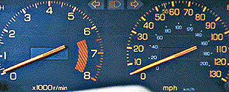
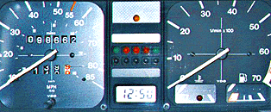
Some problematic designs
How fast am I going?
[www.baddesigns.com]

Slide 7
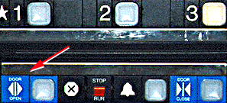
Some problematic designs (2)
How do I get out of the lift?
  Labels that look like pushbuttons
[www.baddesigns.com]

Slide 8
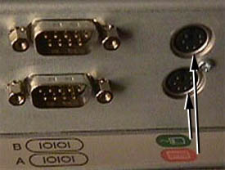


Some problematic designs (3)
Where does the mouse go?
[www.baddesigns.com]

Slide 9
Problematic designs
Lead to daily challenges
Cause frustration and low productivity
Increase the cost of the product
  For example, for a computer
    Costs from a technical perspective
      Hardware
      Software
    Cost from the users’s perspective
      Training costs
      Daily usage

Slide 10
To avoid problematic design we need to...
Take into account
  who the users are
  what activities are being carried out
  where the interaction is taking place
Optimise the interactions users have with a product
  such that they match users’ activities and needs

Slide 11
What is usability?
http://www.usabilitynet.org
Usability is the measure of the quality of a user's experience when interacting with a product or system
  The international standard, ISO 9241-11, defines it as: The extent to which a product can be used by specified users to achieve specified goals with effectiveness, efficiency and satisfaction in a specified context of use.
Usability is about:
  Effectiveness - can users achieve goals with the product?
  Efficiency - how much effort (time) do users require to do this?
  Satisfaction – what do users think about the products ease of use?
….which are affected by:
  The users, their goals, the usage situation (or ‘context of use’)
Usability should not be confused with ‘functionality‘
  Increased functionality does not mean improved usability!
Notes:
Usability means making products and systems easier to use, and matching them more closely to user needs and requirements
The international standard, ISO 9241-11, defines it as:
The extent to which a product can be used by specified users to achieve specified goals with effectiveness, efficiency and satisfaction in a specified context of use.
Usability is about:
Effectiveness - can users complete tasks, achieve goals with the product, i.e. do what they want to do?
Efficiency - how much effort do users require to do this? (Often measured in time)
Satisfaction – what do users think about the products ease of use?
….which are affected by:
The users - who is using the product? e.g. are they highly trained and experienced users, or novices?
Their goals - what are the users trying to do with the product - does it support what they want to do with it?
The usage situation (or 'context of use') - where and how is the product being used?
Usability should not be confused with 'functionality', however, as this is purely concerned with the functions and features of the product and has no bearing on whether users are able to use them or not. Increased functionality does not mean improved usability!

Slide 12
Usability goals
Effectiveness
Efficiency
Safety
Utility
Learnability
Memorability
They all affect users’ satisfaction

Slide 13
Design principles (not exhaustive list)
Visibility – can I see it?
Feedback – what is it doing now?
Constraints – why can’t I do that?
Mapping – where am I and where can I go?
Consistency – I think I have seen this before?
Affordance – how do I use it?
Mental/conceptual models – I think I know how this operates?

Slide 14
Visibility
Can see the state of a device and possible actions
Systems are more usable when they clearly indicate
  their status
  the possible actions that can be performed
  and the consequences of those actions

Slide 15
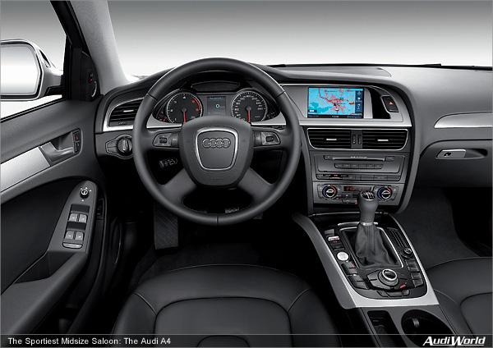
Visibility (1)
Car controls are positioned in a way that they can be easily found and used

Slide 16
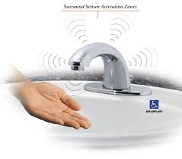
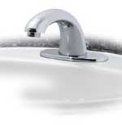
Visibility (2)
Problems arise when we cannot see how to use a device
  Recall our first class and troubles with the laser pointer
  Sensor technology like auto faucets – not sure how to use – guess where to put hands
  Visible knobs, dials and buttons have been replaced by invisible and ambiguous “active zones”

Slide 17
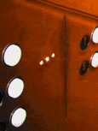
Visibility (3)
This is a control panel for an elevator.
How does it work?
  Push a button for the floor you want?
  Nothing happens. Push any other button? Still nothing. What do you need to do?
It is not visible as to what to do!

Slide 18
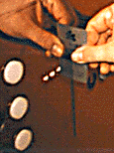
Visibility (3)
You need to insert your room key – a card – into the slot by the buttons
  FESB has a similar system
How would you make this action more visible?
  Make the card reader more obvious
  Provide an auditory message, that says what to do (which language?)
  Provide a big label next to the card reader that flashes when someone enters
  Make relevant parts visible
  Make what has to be done obvious

Slide 19
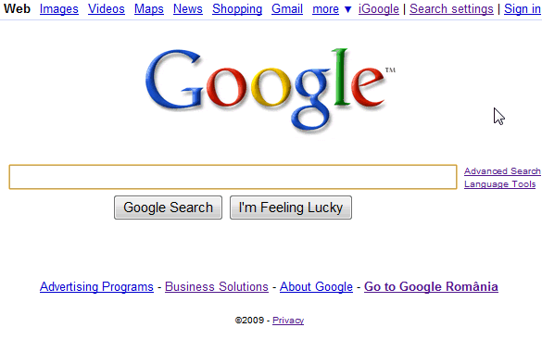
Visibility (4)
Google makes it clear where to enter text

Slide 20
Design principles
Visibility – can I see it?
Feedback – what is it doing now?
Constraints – why can’t I do that?
Mapping – where am I and where can I go?
Consistency – I think I have seen this before?
Affordance – how do I use it?
Mental/conceptual models – I think I know how this operates?

Slide 21
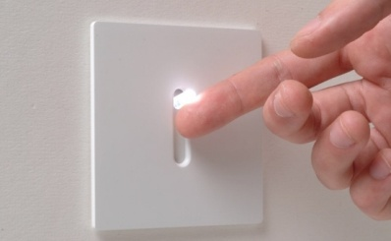
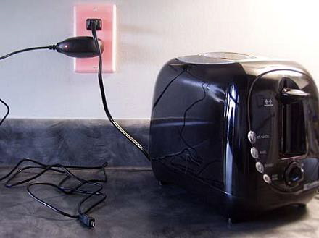
Feedback
What is it doing now?
Sending information back to the user about what has been done
Needs to be immediate and synchronized with user action
Includes sound, highlighting, animation and combinations of these
  Listen to your mouse when you click it
  Can’t it be designed more silent?
  Look around you and find examples of
  feedback
  Glowing switch and power socket

Slide 22
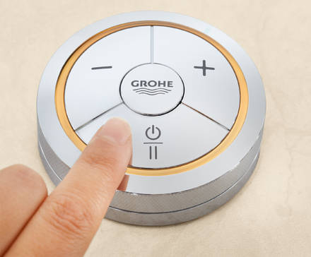
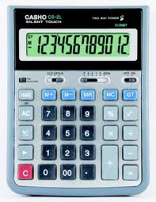
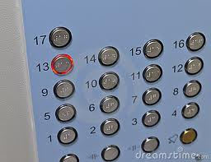
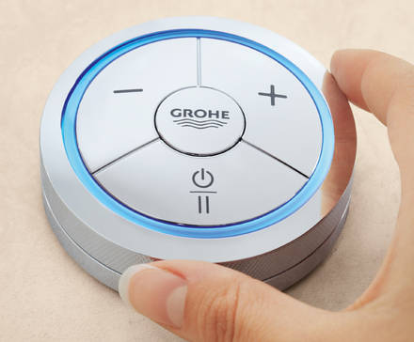
Feedback (1)
Other examples of feedback in everyday design?

Slide 23
Design principles
Visibility – can I see it?
Feedback – what is it doing now?
Constraints – why can’t I do that?
Mapping – where am I and where can I go?
Consistency – I think I have seen this before?
Affordance – how do I use it?
Mental/conceptual models – I think I know how this operates?

Slide 24
Constraints
Restricting the possible actions (the kind of interaction) that can be performed (can take the place)
Helps prevent user from selecting incorrect options

Slide 25
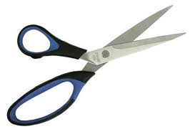
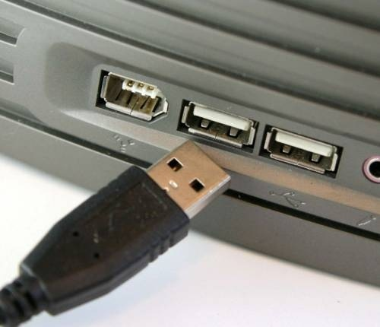
Constraints (1)
Restricting the kind of interaction that can take the place
nowdays
in the past

Slide 26
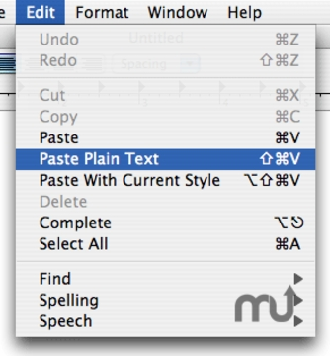
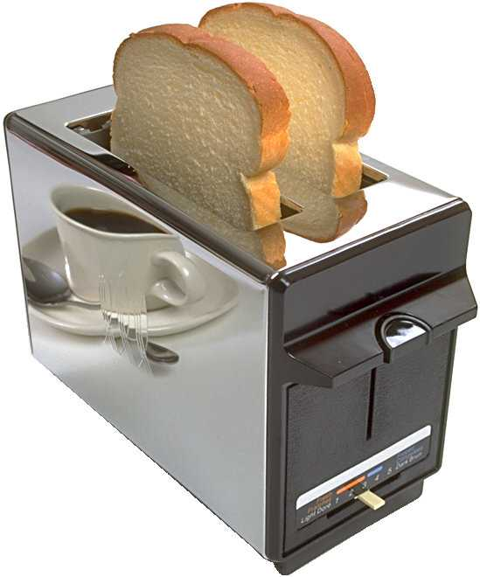
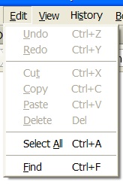
Constraints (2)
Reduce the error

Slide 27
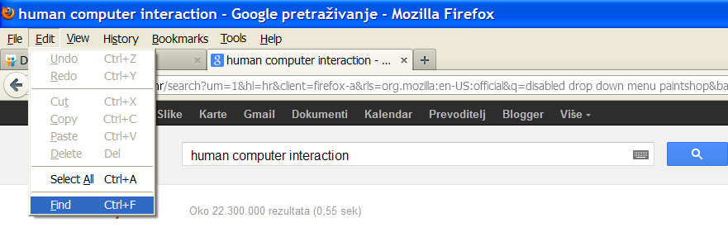
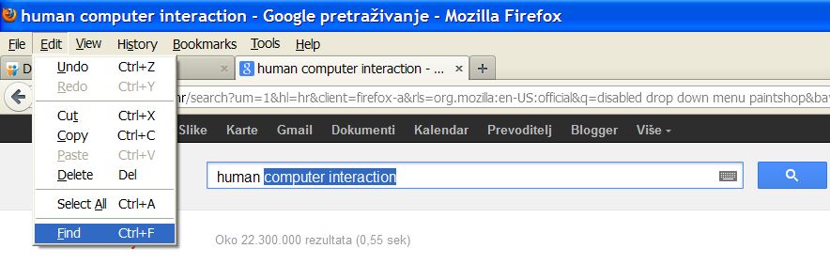
Constraints (3)
Can work to focus the user’s attention to needed task

Slide 28

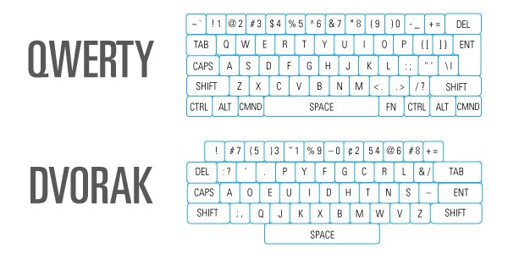
Cultural constraints
We learned arbitrary conventions which help us use technologies
Can apply in a number of ways
  Icons, menus
  Number pads: calculators vs. phone which should computer keypads follow?
  Keyboards (typing Qwerty slower, still we all got used to it)

Slide 29
Design principles
Visibility – can I see it?
Feedback – what is it doing now?
Constraints – why can’t I do that?
Mapping – where am I and where can I go?
Consistency – I think I have seen this before?
Affordance – how do I use it?
Mental/conceptual models – I think I know how this operates?

Slide 30
Mapping
Turn a wheel, flip a switch, or push a button
  What effect do you expect?
Mapping is a relationship between controls and their movements and the results in the world (effects)
Good (natural) mapping -> the effect corresponds to the expectation
Poor mapping -> the effect does not correspond to the expectation
Good mapping between controls and their effects results in greater easy of use

Slide 31
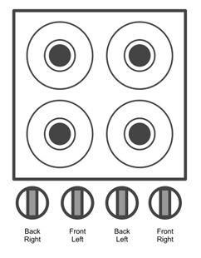
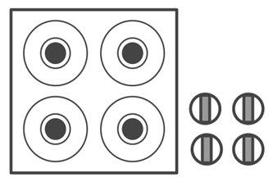
Mapping (1)
Which stove control design provides better mapping? Why?

Slide 32
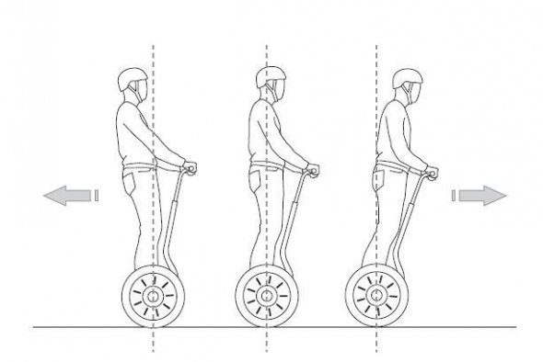
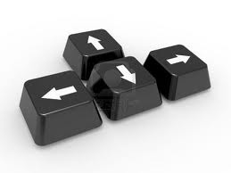
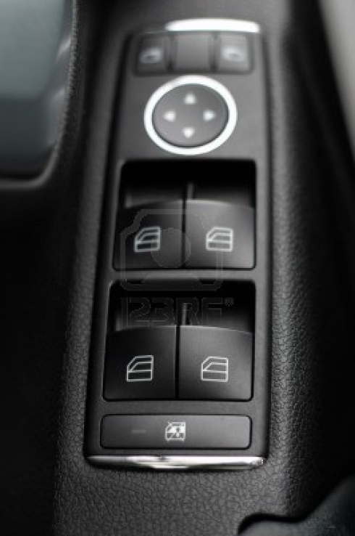
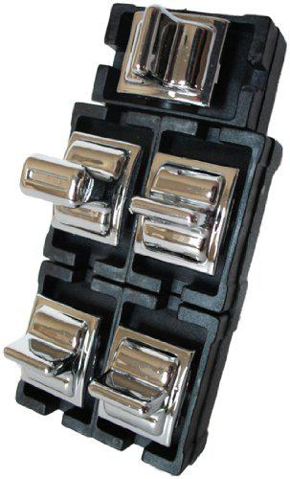
Mapping (2)
2
Good or bad mapping?
1
3
4
What about the switches
in the classrom?

Slide 33
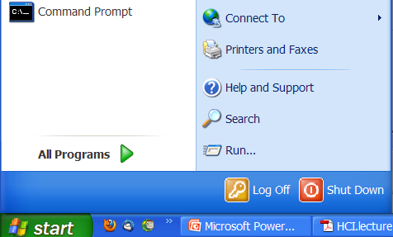
Mapping (3)
Good mapping primarily a function of similarity of
  Layout – e.g., stove controls from the last slide
  Behavior – e.g., steering wheel, Segway
  Meaning – e.g., shut-down button is colored red (people associate red with STOP)

Slide 34
Design principles
Visibility – can I see it?
Feedback – what is it doing now?
Constraints – why can’t I do that?
Mapping – where am I and where can I go?
Consistency – I think I have seen this before?
Affordance – how do I use it?
Mental/conceptual models – I think I know how this operates?

Slide 35
Consistency
Design interfaces to have similar operations and use similar elements for similar tasks
For example:
  Always use ctrl key plus first initial of the command for an operation – Ctrl+C, Ctrl+S, Ctrl+V ...
Main benefit is consistent interfaces are easier to learn and use

Slide 36
Consistency breakdowns
What happens if there is more than one command starting with the same letter?
  e.g. save, spelling, select, style
Have to find other initials or combinations of keys, thereby breaking the consistency rule
  E.g. Ctrl+S, Ctrl+Sp, Ctrl+shift+L
Increases learning burden on user, making them more prone to errors

Slide 37
Internal and external consistency
Internal consistency refers to designing operations to behave the same within an application
  Difficult to achieve with complex interfaces
External consistency refers to designing operations, interfaces, etc., to be the same across applications and devices
  Very rarely the case, based on different designers’ preference

Slide 38
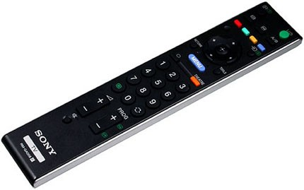
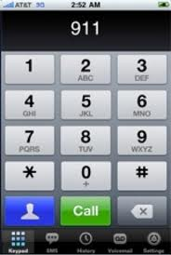
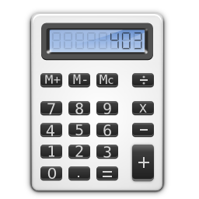
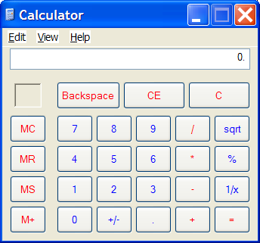
External inconsistency
Phone, remote controls
Calculator

Slide 39
Design principles
Visibility – can I see it?
Feedback – what is it doing now?
Constraints – why can’t I do that?
Mapping – where am I and where can I go?
Consistency – I think I have seen this before?
Affordance – how do I use it?
Mental/conceptual models – I think I know how this operates?

Slide 40
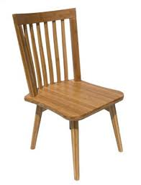
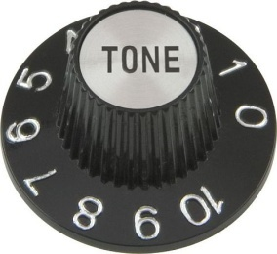
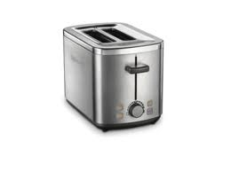
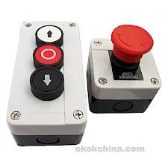
Affordance
Refers to an attribute of an object that allows people to know how to use it
How something looks indicates how it’s can be used
  Chair for sitting
  Table for placing things on
  Knobs for turning
  Slots for inserting things into
  Buttons for pushing

Slide 41
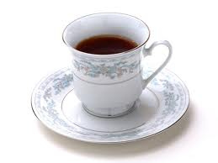
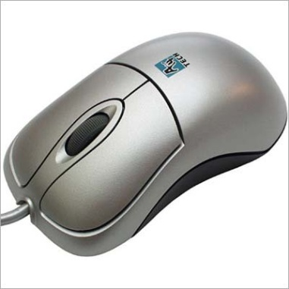
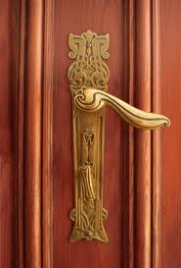
Affordance (1)
Refers to an attribute of an object that allows people to know how to use it

Slide 42

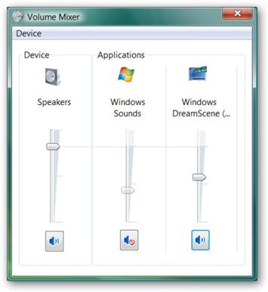
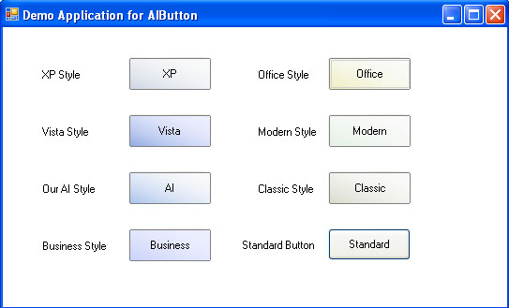
Affordance (2)
Refers to an attribute of an object that allows people to know how to use it

Slide 43
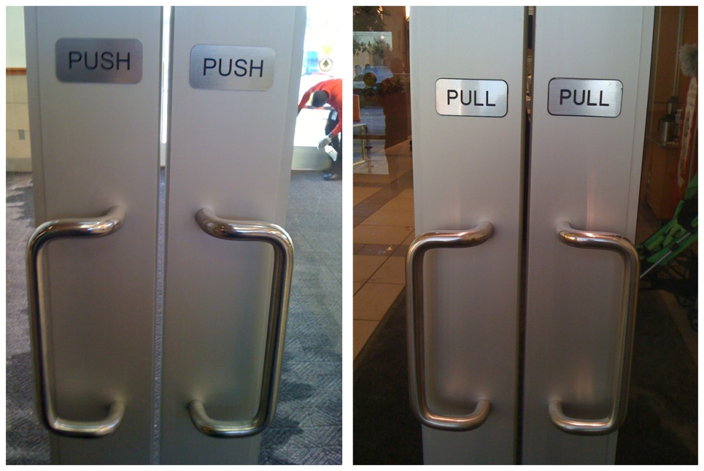
Affordance (3)
Complex things may need explaining, but simple things should not
  When simple things need pictures, labels, instructions, then design has failed
  Their usage should be obvious based upon their appearance
Both sides don’t have to look the same. The pull side can have a handle, the other side can have a big metal plate or a push bar. A handle sends out a signal: grab me and pull. A metal plate cannot be pulled, so you have only one option: push. Designing each side of the door appropriately eliminates confusion because the perceived affordances are now more focused on the intended action.

Slide 44
Design principles
Visibility – can I see it?
Feedback – what is it doing now?
Constraints – why can’t I do that?
Mapping – where am I and where can I go?
Consistency – I think I have seen this before?
Affordance – how do I use it?
Mental/conceptual models – I think I know how this operates?

Slide 45
Mental model
Representations of systems derived from experience
People understand and interact with systems based on mental representations developed from experience
  They compare the outcomes of their mental models with the real-world systems:
  When the outcomes correspond, a mental model is accurate
  When the outcomes do not correspond, the mental model is inaccurate or incomplete

Slide 46
Mental model (1)
A mental model allows the user to simulate the operation of the device
A good mental model allows the user to predict the effects of their actions
Mental models built from:
  Affordances and constraints
  Mappings
  Transfer effects
  Population stereotypes/cultural standards
  Instructions
  Interactions

Slide 47
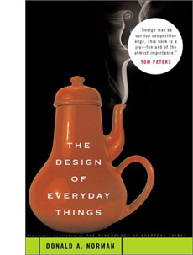
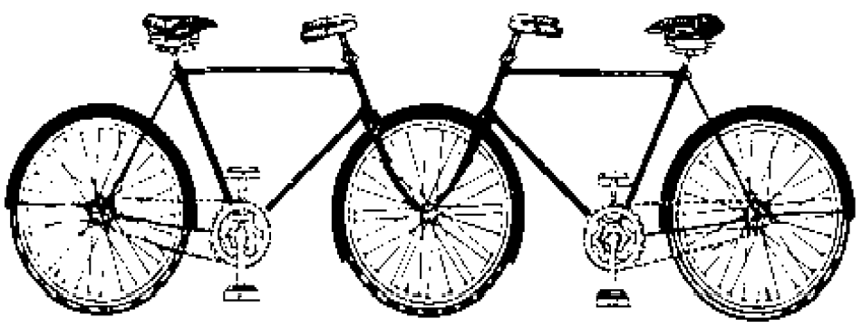
Mental model (2)
Models allow people to mentally simulate operation of design (device, software,...)
Models may be wrong, particularly if the above attributes are misleading

Slide 48
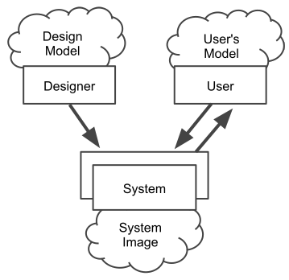
Mental model (3)
With regards to design, there are two basic types of mental models
  System models – mental models of how systems work
  Interaction models – mental models of how people interact with systems
Designers have accurate system
models, but weak interaction model
Users have inaccurate system models,
but through use and experience attain
accurate interaction models
Optimal design only when designers
have accurate system and interaction model
  Usability testing, observing people unfamiliar
  with the system
Interface

Slide 49
Mental model: the case of ABS (4)
Anti-lock braking system (ABS) vs. conventional brakes
Statistics show that ABS have not reduced the frequency or cost of accidents
  In spite of the fact that they have measurable safety benefits in controlled tests
  Why is this so?
We can explain this by using the concept of wrong interaction/mental model

Slide 50
Mental model: the case of ABS (5)
Good interaction model for conventional brakes
  On slick surfaces
    Depress the brake pedal smoothly
    Pump brakes to prevent them from locking up
    Do not steer while braking, except to counter-steer
    Noise and vibrations are signs that something is wrong
Good interaction model for ABS
  On slick surfaces
    Depress the brake pedal fast and hard
    Do not pump breaks
    Steer while braking
    Noise and vibrations are signs that the system is operating properly

Slide 51
Mental model: the case of ABS (6)
The likely cause that ABS have not made the difference
  People are not using ABS properly (wrong metal model)
  They transfer the knowledge from conventional breaks
  All this simply means that ABS are not properly designed
  It also suggests that designers gave little consideration to the interaction model of the target audience in the design process
So, design with people’s interaction models in mind

Slide 52
Final thoughts: individual differences
Who do you design for?
People are different
It is rarely possible to accommodate all people perfectly
Rule of thumb:
  Designing for the average is a mistake
    May exclude half the audience
  Design should aim at 95% of audience
    But means 5% of population may be (seriously!) compromised
Examples:
  Cars and height: headroom, seat size
  Computers and visibility:
    Font size, line thickness, alternatives to color for color blind people?

Slide 53
Final thoughts: individual differences
You do NOT necessarily represent a good representative user of equipment or systems you design
Do not expect others to think and behave as you do, or as you might like them to
People vary in thought and behaviour just as they do physically
Design for and with a user!

Slide 54
What you know now
Many so-called human errors are actually errors in design
  Don’t blame the user!
Designers help make things easier to use by providing a good mental/conceptual model through
  Affordances
  Constraints
  Mapping
  Visibility
  Population stereotypes
  Positive transfers
Design to accommodate individual differences
  Decide on the range of users

